Slide 1


并行程序开发
任课教师：王桢

Slide 2
课程内容
参考资料：
并行程序设计导论，Peter S Pacheco, 机械工业出版社， 2016
Chapter 6 Parallel Program Development

Slide 3
Roadmap
Solving non-trivial problems.
The n-body problem.
The traveling salesman problem.
Applying Foster’s methodology.
Starting from scratch on algorithms that have no serial analog.

Slide 4


Two N-Body Solvers

Slide 5
The n-body problem
Find the positions and velocities of a collection of interacting particles over a period of time.
An n-body solver is a program that finds the solution to an n-body problem by simulating the behavior of the particles.

Slide 6
Position_{time 0}
Position_{time x}
N-body solver
mass
Velocity_{time x}
Velocity_{time 0}

Slide 7
Simulating motion of planets
Determine the positions and velocities:
Newton’s second law of motion.
Newton’s law of universal gravitation.

Slide 8
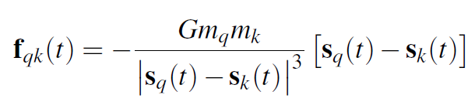






Force on particle q exerted by k
mass
$$|S_{q}\left(t\right)−S_{k}\left(t\right)|$$
$$m_{q}$$
q
k
$$m_{k}$$
distance
$$S_{q}\left(t\right)$$
$$S_{k}\left(t\right)$$
G: gravitational constant
position

Slide 9
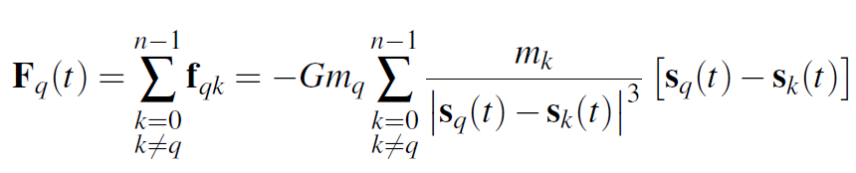




Total force on particle q
0
$$f_{q0}$$
…
$$f_{qk}$$
$$m_{q}$$
q
k
$$m_{k}$$
$$S_{q}\left(t\right)$$
$$f_{q,n−1}$$
$$S_{k}\left(t\right)$$
…
n-1

Slide 10
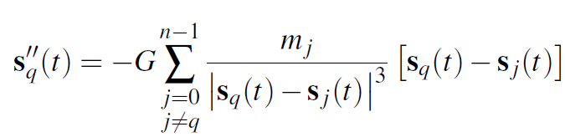



Acceleration of particle q
According to Newton’s second law of motion:
$$F_{q}\left(t\right)=m_{q}a_{q}\left(t\right)=m_{q}S_{q}^{′′}\left(t\right)$$
$${a_{q}\left(t\right)=S}_{q}^{′′}\left(t\right)=\frac{F_{q}\left(t\right)}{m_{q}}$$

Slide 11
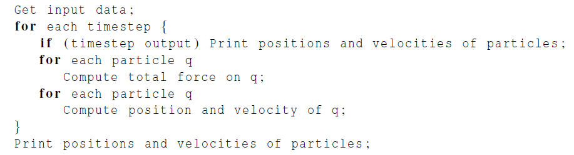
Serial pseudo-code

Slide 12
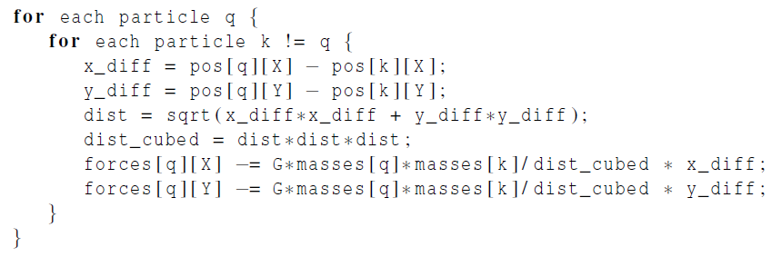
Computation of the forces
k
dist
y_diff
q
x_diff

Slide 13


Newton’s third law of motion
For every action, there is an equal and opposite reaction.
The force on q due to k
$$f_{qk}$$
q
k
$$f_{kq}=−f_{qk}$$
The force on k due to q

Slide 14
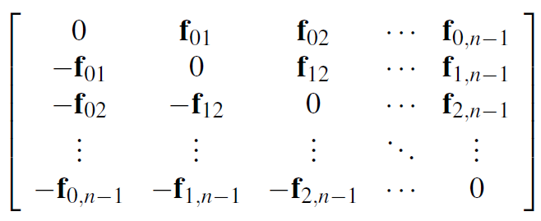




The individual forces
$$f_{qk}$$
$$f_{kq}=−f_{qk}$$
$$f_{qk}$$
q
k
$$f_{kq}=−f_{qk}$$

Slide 15
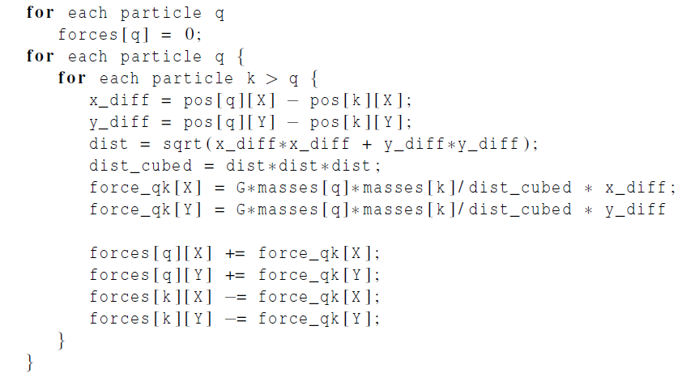
A Reduced Algorithm for Computing N-Body Forces

Slide 16
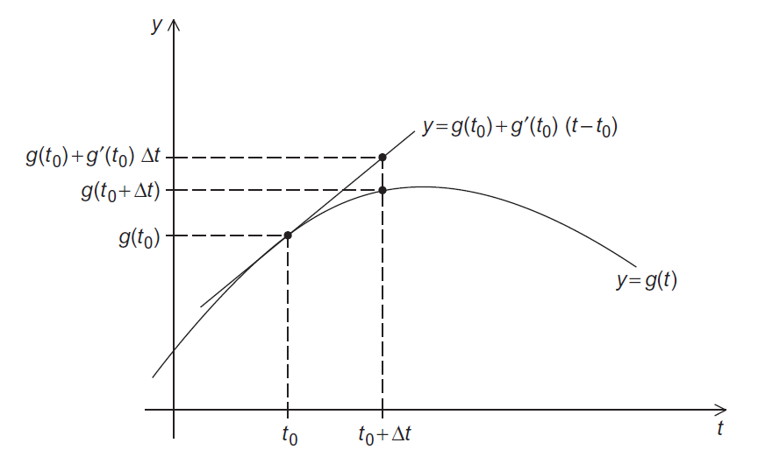
Using the Tangent Line to Approximate a Function

Slide 17
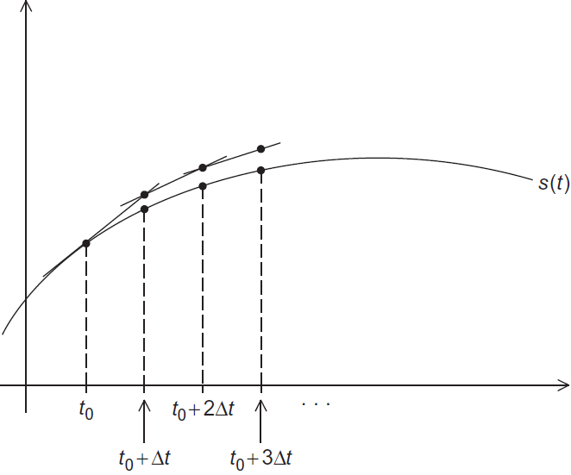
Euler’s Method

Slide 18
Parallelizing the N-Body Solvers
Apply Foster’s methodology.
Initially, we want a lot of tasks.
Start by making our tasks the computations of the positions, the velocities, and the total forces at each timestep.

Slide 19
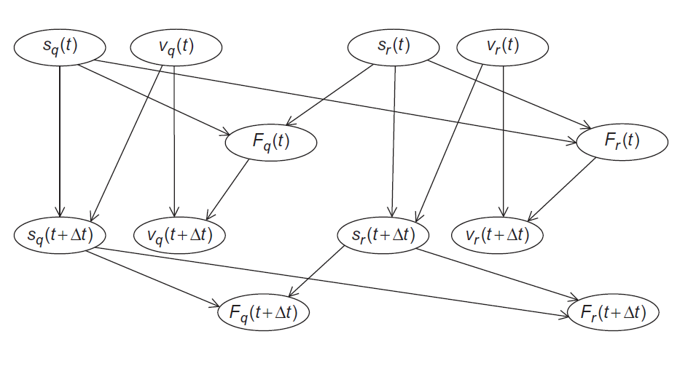
Communications Among Tasks in the Basic N-Body Solver

Slide 20
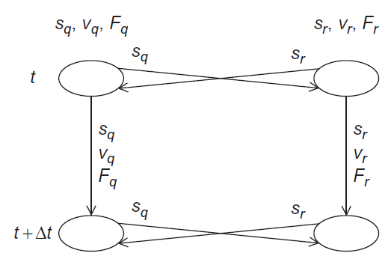
Communications Among Agglomerated Tasks in the Basic N-Body Solver

Slide 21
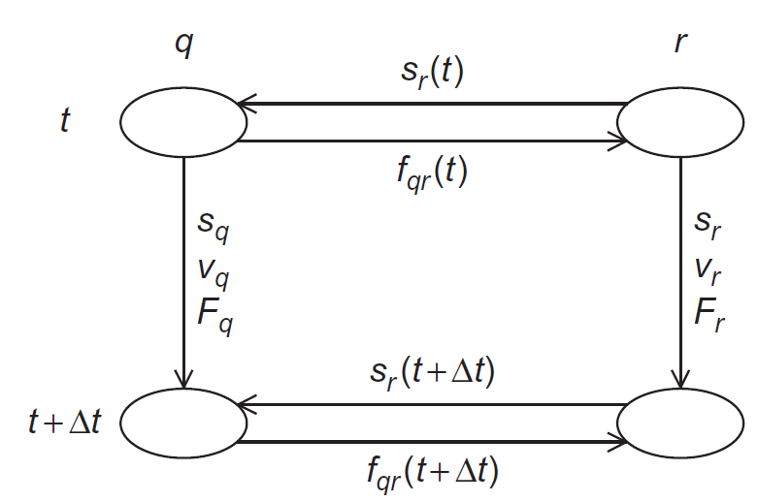
Communications Among Agglomerated Tasks in the Reduced N-Body Solver
q < r

Slide 22
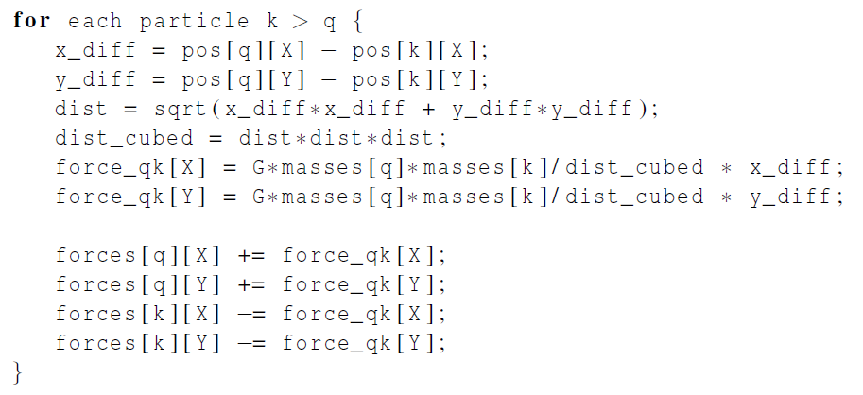
Computing the total force on particle q in the reduced algorithm

Slide 23
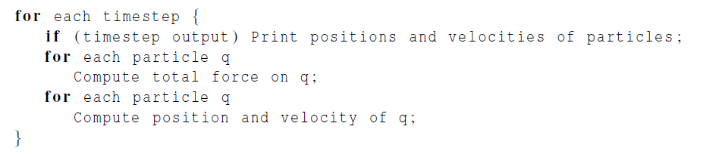
Serial pseudo-code
iterating over particles
In principle, parallelizing the two inner
for loops will map tasks/particles to cores.

Slide 24
Parallelizing the Basic Solver using OpenMP

Slide 25
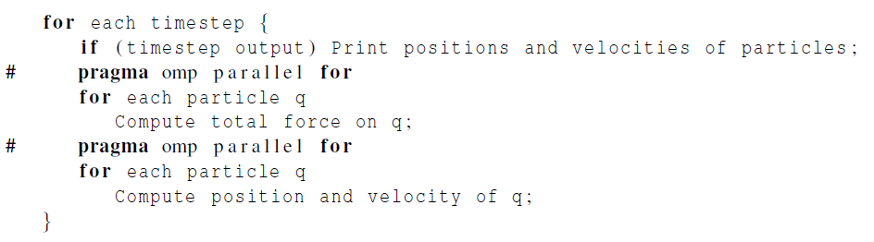
First attempt
Let’s check for race conditions caused by loop-carried dependences.

Slide 26
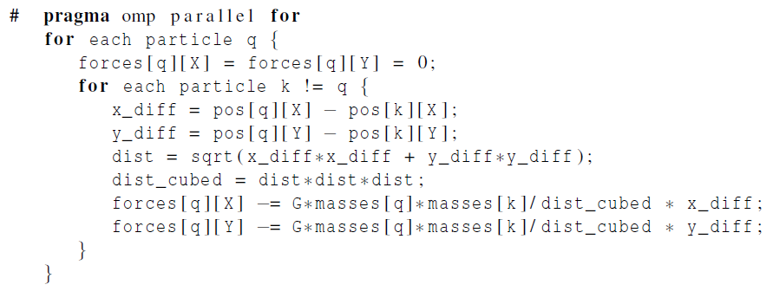
First loop
No race conditions in parallelization of the first loop
Only one thread will access forces[q] for any q.
Accesses to pos and masses array are read.

Slide 27
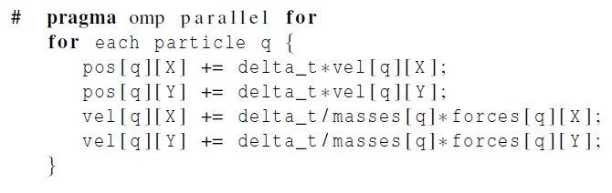
Second loop
No race conditions in parallelization of the second loop
A single thread accesses pos[q], vel[q], masses[q], forces[q] for any particle q.
Scalar variables are only read.

Slide 28
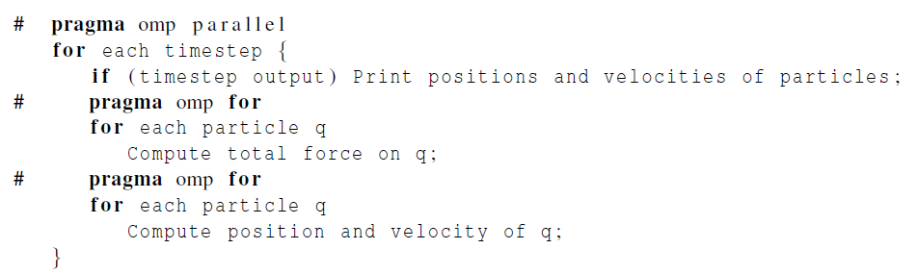
Repeated forking and joining of threads
The same team of threads will be used in both loops and for every iteration of the outer loop.
Problem: every thread will print all the positions and velocities.

Slide 29
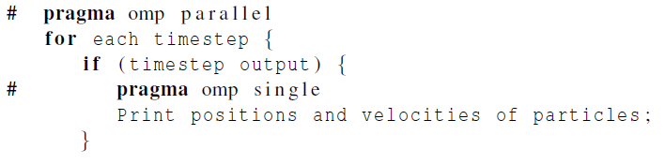
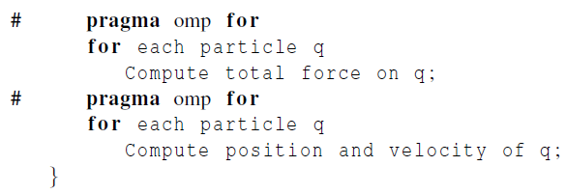
Adding the single directive
Single: only one of the threads can execute the following block of code.

Slide 30
Parallelizing the Reduced Solver using OpenMP

Slide 31
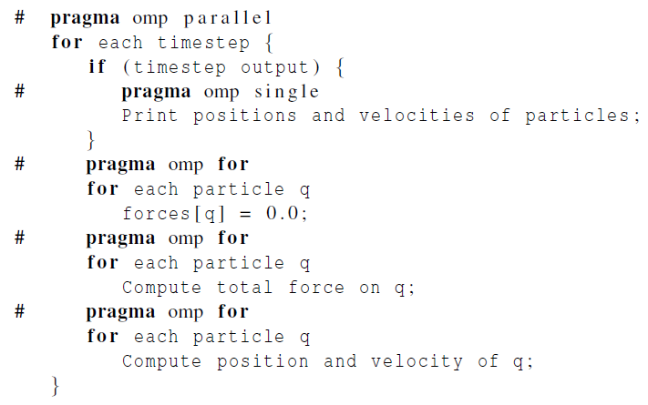
Parallelizing the Reduced Solver Using OpenMP
Parallelization of the initialization of forces is fine, as there is no dependence among the iterations.

Slide 32


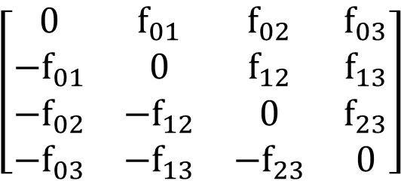
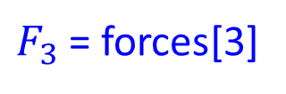
Problems
Why?
Updates to forces[3] create a race condition.
Unlike basic version, in the reduced version, a thread may update elements in the forces array other than those corresponding to its assigned particles.
$$\left[\begin{matrix}0 & f_{01} & f_{02} & f_{03} \\ {−f}_{01} & 0 & f_{12} & f_{13} \\ {−f}_{02} & −f_{12} & 0 & f_{23} \\ {−f}_{03} & −f_{13} & −f_{23} & 0\end{matrix}\right]$$
Thread 0
$F_{3}$ = forces[3]
Thread 1

Slide 33
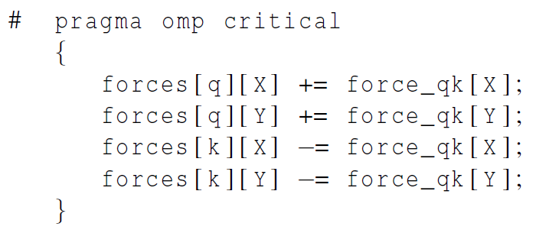
First solution attempt
before all the updates to forces
Drawback: Access to the forces array will be effectively serialized!!!

Slide 34
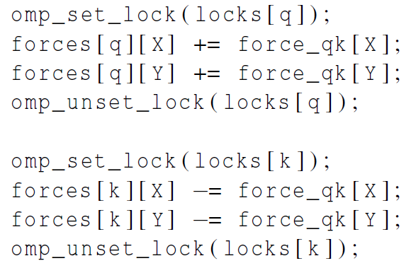
Second solution attempt
Use one lock for each particle.
The performance is not as good as serial code.

Slide 35
Third solution attempt
Solution: to carry out the computation of forces in two phases:
(Phase I) each thread performs calculations and stores results in its own array of forces;
(Phase II) the thread that has been assigned particle q will add the contributions that have been computed by different threads.
Thread 0
Thread 1

Slide 36
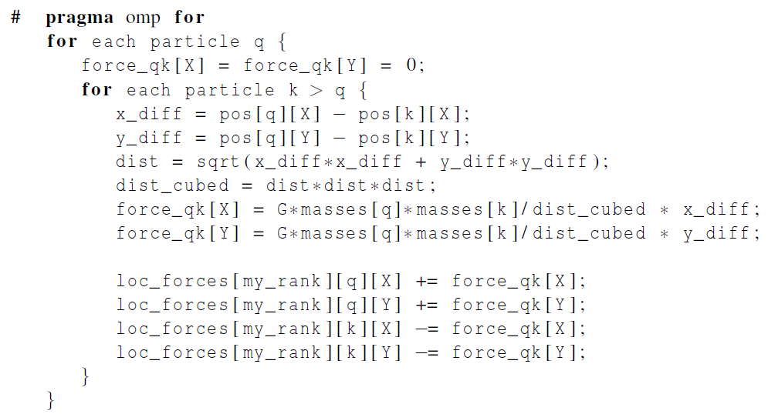
Revised algorithm – phase I
(1) each thread performs calculations and stores results in its own array of forces;

Slide 37
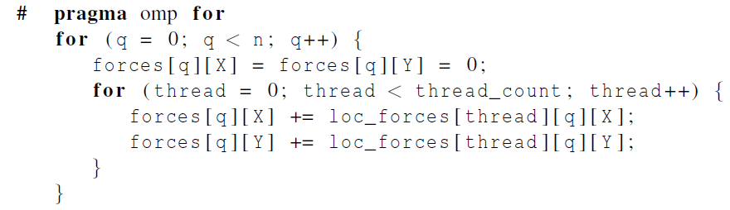
Revised algorithm – phase II
(2) the thread that has been assigned particle q will add the contributions that have been computed by different threads.

Slide 38

Another example
6 particles, 3 threads, block partition
$$\left[\begin{matrix}0 & f_{01} & f_{02} & f_{03} & f_{04} & f_{05} \\ {−f}_{01} & 0 & f_{12} & f_{13} & f_{14} & f_{15} \\ {−f}_{02} & −f_{12} & 0 & f_{23} & f_{24} & f_{25} \\ {−f}_{03} & −f_{13} & −f_{23} & 0 & f_{34} & f_{35} \\ −f_{04} & −f_{14} & −f_{24} & −f_{34} & 0 & f_{45} \\ −f_{05} & −f_{15} & −f_{25} & −f_{35} & −f_{45} & 0\end{matrix}\right]$$
Particle 0
Thread 0
Particle 1
Particle 2
Thread 1
Particle 3
Particle 4
Thread 2
Particle 5

Slide 39
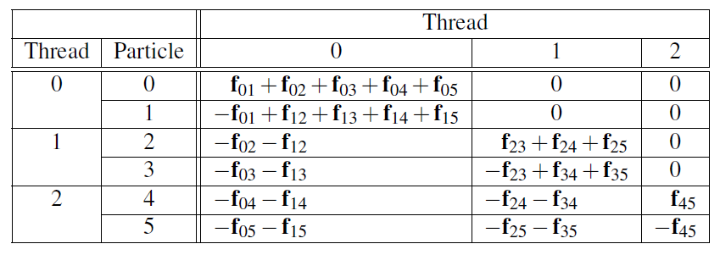
First Phase Computations for Reduced Algorithm with Block Partition
Imbalanced workload among three threads
Notes:
最后三列每列是对应线程在第一阶段的工作量

Slide 40
Another example - continued
6 particles, 3 threads, cyclic partition
Thread 0
$$\left[\begin{matrix}0 & f_{01} & f_{02} & f_{03} & f_{04} & f_{05} \\ {−f}_{01} & 0 & f_{12} & f_{13} & f_{14} & f_{15} \\ {−f}_{02} & −f_{12} & 0 & f_{23} & f_{24} & f_{25} \\ {−f}_{03} & −f_{13} & −f_{23} & 0 & f_{34} & f_{35} \\ −f_{04} & −f_{14} & −f_{24} & −f_{34} & 0 & f_{45} \\ −f_{05} & −f_{15} & −f_{25} & −f_{35} & −f_{45} & 0\end{matrix}\right]$$
Particle 0
Thread 1
Particle 1
Thread 2
Particle 2
Thread 0
Particle 3
Thread 1
Particle 4
Thread 2
Particle 5

Slide 41
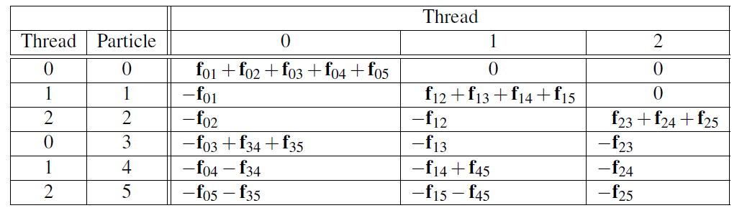
First Phase Computations for Reduced Algorithm with Cyclic Partition
More balanced workload among three threads with cyclic partition

Slide 42
Parallelizing the Solvers using Pthreads

Slide 43
Parallelizing the Solvers Using Pthreads
By default, local variables in Pthreads are private.
All shared variables are global in the Pthreads.
The principle data structures in the Pthreads version are identical to those in the OpenMP version
Startup for Pthreads is basically the same as the startup for OpenMP

Slide 44
Parallelizing the Solvers Using Pthreads
The main difference between Pthreads and OpenMP is in the details of parallelizing the inner loops.
We must explicitly determine which values of the loop variables correspond to each thread’s calculations.

Slide 45
Parallelizing the Solvers Using Pthreads
Another difference between the Pthreads and the OpenMP versions has to do with barriers.
At the end of a parallel for OpenMP has an implied barrier.
For Pthreads, we need to add explicit barriers after the inner loops when a race condition can arise.
The Pthreads standard includes a barrier. However, some systems don’t implement it.

Slide 46
Parallelizing the Solvers using MPI

Slide 47
Parallelizing the Basic Solver Using MPI
Choices with respect to the data structures:
Each process stores the entire global array of particle masses.
Each process only uses a single n-element array for the positions.
Each process uses a pointer loc_pos that refers to the start of its block of pos.
On process 0 local_pos = pos;
on process 1 local_pos = pos + loc_n;
etc.
Notes:
教材p196 MPI_IN_PLACE

Slide 48
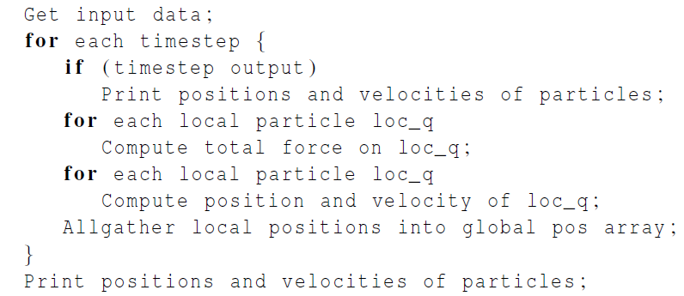
Pseudo-code for the MPI version of the basic n-body solver

Slide 49
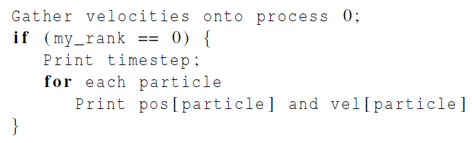

Pseudo-code for output

Slide 50
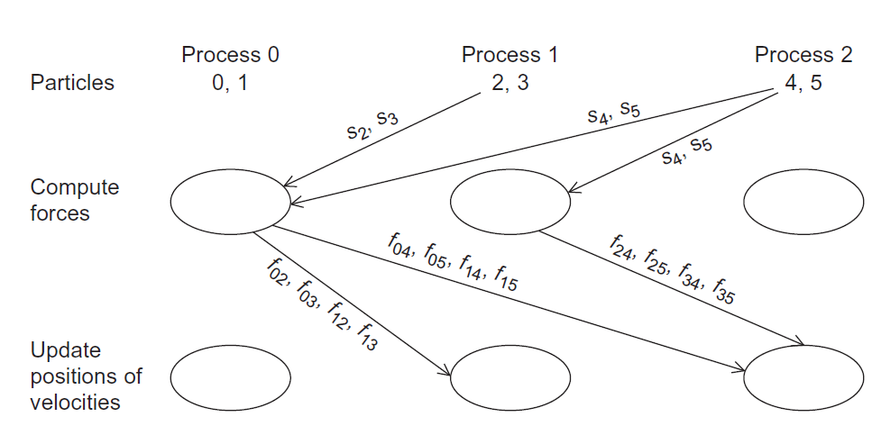
Communication In A Possible MPI Implementation of the N-Body Solver (for a reduced solver)
Complicated!
Unless the implementation were very carefully done, it would probably be very slow.

Slide 51
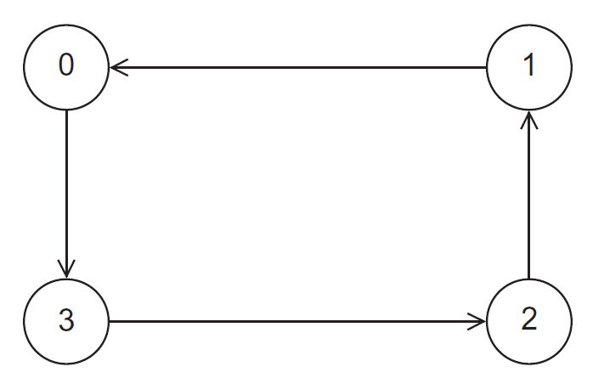
A Ring of Processes
By repeatedly sending and receiving data using the ring, each process has access to positions of all the particles.

Slide 52
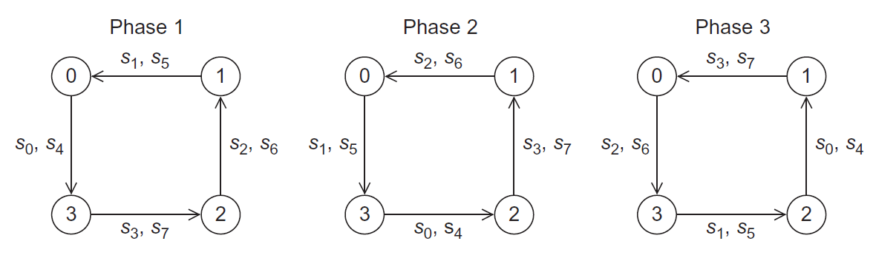
Ring Pass of Positions
4 processes, 8 particles, cyclic partition
Phase 1: each process will send positions of its assigned particles to its “lower-ranked” neighbor and receive positions of particles assigned to its “higher-ranked” neighbor
Phase 2: each process will forward the positions it received in the first phase.

Slide 53
Computation of Forces in Ring Pass
In each phase, a process can
(1) compute inter-particle forces resulting from interaction between its assigned particles and the particles whose positions it has received;
(2) once an inter-particle force has been computed, the process can add the force into a local array of forces, and subtract the force from the received array of forces.

Slide 54
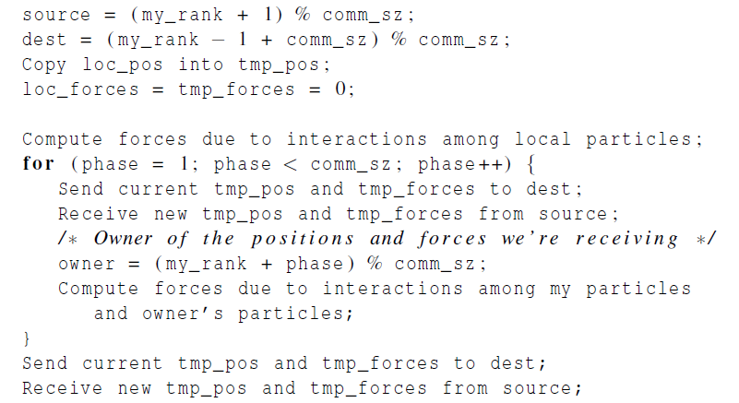
Pseudo-code for the MPI implementation of the reduced n-body solver

Slide 55
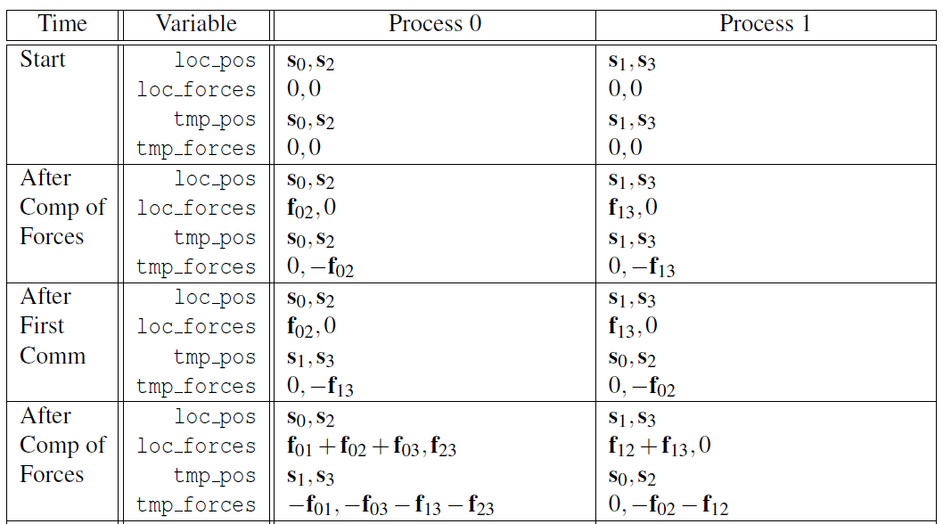
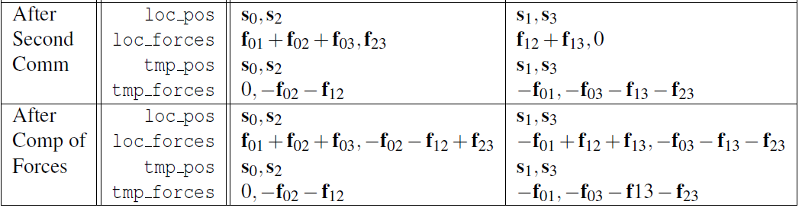
Computation of Forces in Ring Pass
2 processes, 4 particles, cyclic partition
Final phase: carry out a vector sum

Slide 56
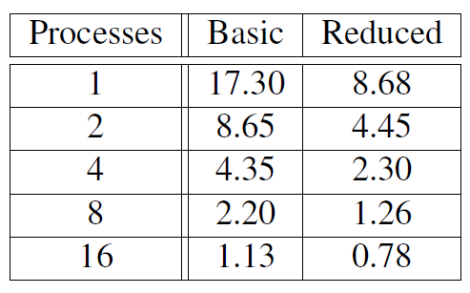
Performance of the MPI n-body solvers
(in seconds)
Reduced solver is better than basic solver

Slide 57
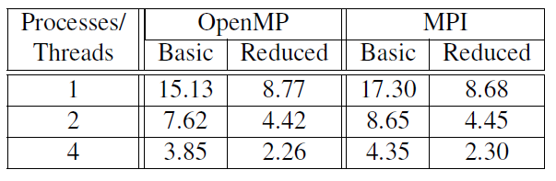
Run-Times for OpenMP and MPI N-Body Solvers
(in seconds)
Basic OpenMP solver is faster than basic MPI solver.
Reduced solver: OpenMP ≈ MPI

Slide 58

Tree search

Slide 59
Tree search problem (TSP)
An NP-complete problem.
No known solution to TSP that is better in all cases than exhaustive search.
Ex., the travelling salesperson problem, finding a minimum cost tour.
Notes:
NP完全问题

Slide 60
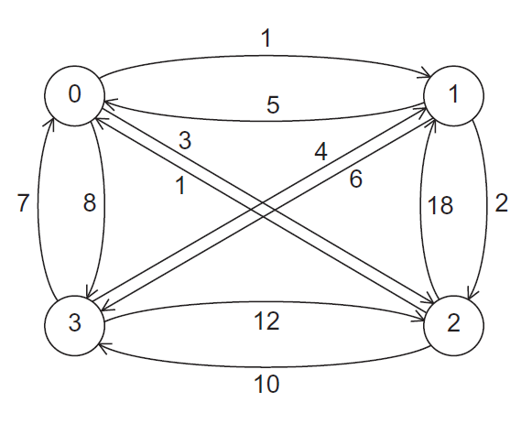

A Four-City TSP

Slide 61
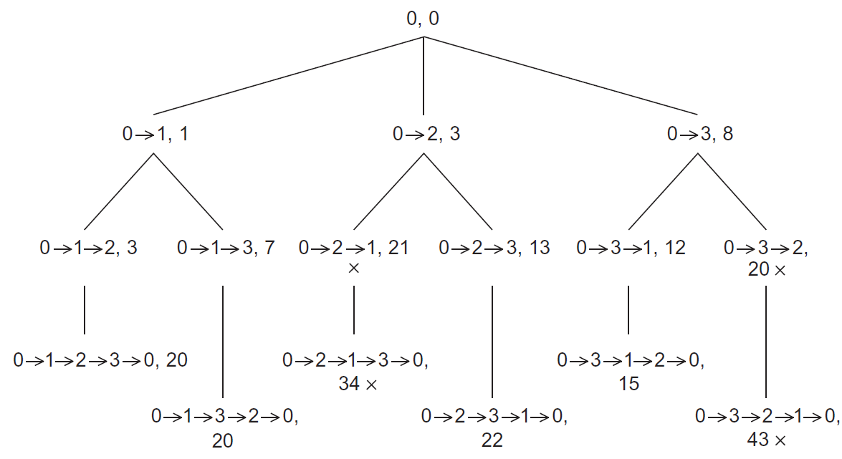
Search Tree for Four-City TSP

Slide 62
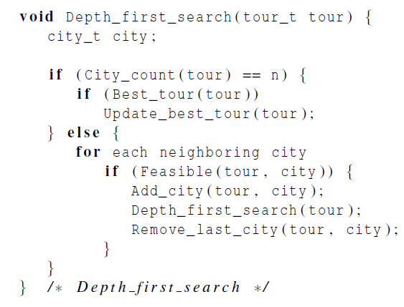
Pseudo-code for a recursive solution to TSP using depth-first search
To see if there are n cities in the partial tour
To see if the complete tour has a lower cost than the current “best tour”
Replace the current best tour with the tour
To see if city has been visited, and if not, whether the city can possibly lead to a least-cost tour.
Remove city from the tour, as it shouldn’t be included in the tour in subsequent recursive calls.

Slide 63
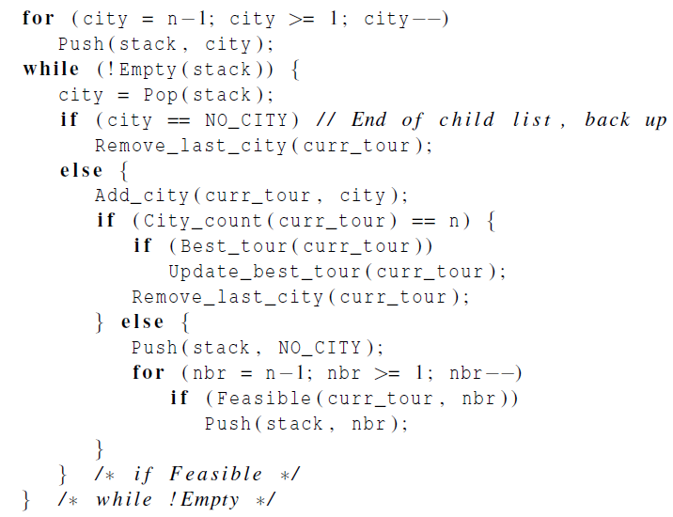
Pseudo-code for an implementation of a depth-first solution to TSP without recursion
NO_CITY is a marker so that we can tell when we’ve visited all children of a tree node
2
0
1
N
1
2
4
3
N
3
4
N
N
Before pushing all children of a node, we push NO_CITY marker

Slide 64
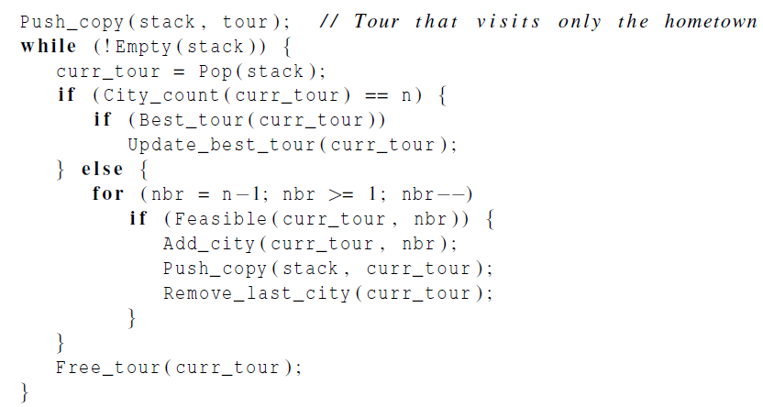
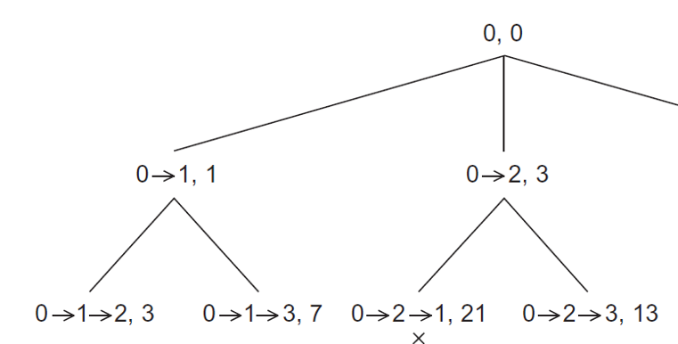





Pseudo-code for a second solution to TSP that doesn’t use recursion
Stack

Slide 65
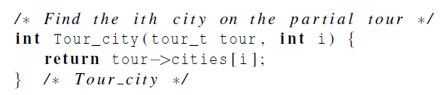

Using pre-processor macros

Slide 66
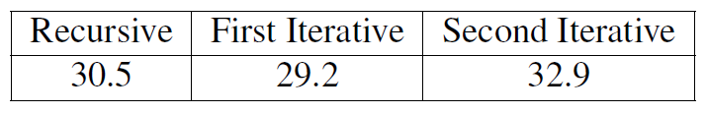

Run-Times of the Three Serial Implementations of Tree Search
(in seconds)
First iterative solution is faster, as it eliminates some overhead due to repeated function calls.
Second iterative solution is slower because of repeated copying of tour data structure.
The second iterative one is easy to parallelize.

Slide 67
Making sure we have the “best tour” (1)
When a process finishes a tour, it needs to check if it has a better solution than recorded so far.
The global Best_tour function only reads the global best cost, so we don’t need to tie it up by locking it. There’s no contention with other readers.
If the process does not have a better solution, then it does not attempt an update.

Slide 68
Making sure we have the “best tour” (2)
If another thread is updating while we read, we may see the old value or the new value.
The new value is preferable, but to ensure this would be more costly than it is worth.

Slide 69
Making sure we have the “best tour” (3)
In the case where a thread tests and decides it has a better global solution, we need to ensure two things:
1) That the process locks the value with a mutex, preventing a race condition.
2) In the possible event that the first check was against an old value while another process was updating, we do not put a worse value than the new one that was being written.
We handle this by locking, then testing again.

Slide 70
First scenario
global tour value
process y
process x
local tour value
local tour value
30
27
22
22
27
3. test
1. test
6. lock
2. lock
7. test again
4. update
8. update
5. unlock
9. unlock

Slide 71
Second scenario
global tour value
process y
process x
local tour value
local tour value
30
27
29
27
3. test
1. test
6. lock
2. lock
7. test again
4. update
8. unlock
5. unlock

Slide 72

Parallelizing the Tree Search Programs Using Pthreads

Slide 73
Static Parallelization of Tree Search using Pthreads
Idea: a single thread use BFS to generate at least thread_count partial tours to distribute among threads, then each thread takes its partial tours and runs iterative tree search on them.
Four differences compared with iterative serial one:
The use of my_stack instead of stack;
Initialization of the stack;
Implementation of Best_tour func;
Implementation of Update_best_tour func.

Slide 74
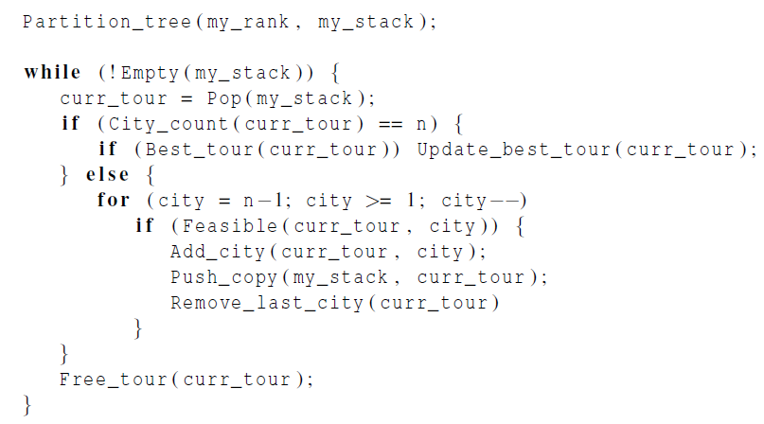
Pseudo-code for a Pthreads implementation of a statically parallelized solution to TSP

Slide 75
Dynamic Parallelization of Tree Search using Pthreads
Basic Idea:
when a thread runs out of work, it waits to see if another thread can provide more work.
if a thread still has work and finds that there is at least one thread without work, it can split its stack and provide work for one of the threads.
Note: using pthread_cond_wait, pthread_cond_signal, pthread_cond_broadcast for implementation.

Slide 76
Dynamic Parallelization of Tree Search Using Pthreads
Code executed by a thread before it splits:
It checks that it has at least two tours in its stack.
It checks that there are threads waiting.
It checks whether the new_stack variable is NULL.
Termination issues.
Only when all the threads have run out of work.
Terminated function is used instead of Empty(stack)

Slide 77

Pseudo-Code for Pthreads Terminated Function (1)

Slide 78

Pseudo-Code for Pthreads Terminated Function (2)

Slide 79

Grouping the termination variables

Slide 80

Run-times of Pthreads tree search programs
15-city problems
(in seconds)
numbers of times
stacks were split

Slide 81
Parallelizing the Tree Search Programs Using OpenMP

Slide 82


Parallelizing the Tree Search Programs Using OpenMP
Same basic issues implementing the static and dynamic parallel tree search programs as Pthreads.
A few small changes can be noted.
Pthreads
OpenMP
Notes:
Pragma omp master没有隐式barrier！

Slide 83

OpenMP emulated condition wait
Busy-waiting !

Slide 84

Performance of OpenMP and Pthreads implementations of tree search
(in seconds)
For most parts, OpenMP implementation is comparable to Pthreads implementation.

Slide 85
Implementation of Tree Search Using MPI and Static Partitioning

Slide 86
Implementation using MPI and static partitioning
Read the adjacency matrix on process 0, and broadcast it to all the processes;
Partitioning the tree
Checking and updating the best tour
After the search has terminated, making sure that process 0 has a copy of the best tour for output

Slide 87

Partitioning the tree
MPI_Scatter: cannot be used, as # of initial partial tours may not be evenly divisible by comm_sz.
MPI_Scatterv: a variant of MPI_Scatter, which can send different # of objects to different processes.
Data sent to process q will begin in location (sendtype = MPI_INT)
sendbuf + displacement[q]

Slide 88

Gathering a different number of objects from each process in the communicator
MPI_Gatherv: a variant of MPI_Gather, which can gather different # of objects from different processes.

Slide 89
Maintaining the best tour
When a process finds a new best tour, it should send it to other processes.
MPI_Bcast cannot be used, as it is blocking.
Every process in the communicator must call MPI_Bcast.
New tour should be sent in a way that the sender won’t block indefinitely.

Slide 90
Maintaining the best tour
The simplest way is to use MPI_send to send the new best cost to all the other processes.
Use a special tag NEW_COST_TAG.
The destination processes can periodically check for the arrival of new best tour costs.
Problem: we cannot use MPI_Recv as the process will block until a matching message arrives.

Slide 91


Maintaining the best tour
MPI_Iprobe: checking to see if a message is available
It doesn’t actually try to receive a message
Status_p->MPI_SOURCE will be assigned the rank of message source
If such a msg is available,*msg_avail_p is assigned TRUE

Slide 92
MPI code to check for new best tour costs
MPI_Iprobe(MPI_ANY_SOURCE, NEW_COST_TAG, comm,
&msg_avail, &status);
while(msg_avail)
{
MPI_Recv(&received_cost, 1, MPI_INT, status.MPI_SOURCE,
NEW_COST_TAG, comm, MPI_STATUS_IGNORE );
if (received_cost < best_tour_cost)
best_tour_cost = received_cost;
MPI_Iprobe(MPI_ANY_SOURCE, NEW_COST_TAG, comm,
&msg_avail, &status);
}

Slide 93
Modes and Buffered Sends - 1
MPI provides four modes for sends.
Standard: MPI_Send
Synchronous: MPI_Ssend
Ready: MPI_Rsend
Buffered: MPI_Bsend

Slide 94
Modes and Buffered Sends - 2
Standard: MPI_Send
MPI implementation decides whether to copy the message content into its own storage, or to block until a matching receive is posted.
Synchronous: MPI_Ssend
The send will block until a matching receive is posted

Slide 95
Modes and Buffered Sends - 3
Ready: MPI_Rsend
The send is erroneous unless a matching Receive is posted before the Send is started.
Buffered: MPI_Bsend
MPI implementation must copy the message into local temporary storage if a matching Receive hasn’t been posted.
The temporary storage must be provided by the user program, not MPI implementation.
Notes:
MPI_Buffer_attach()

Slide 96


Printing the best tour
Have each process store its local best tour
After completing searches, call MPI_Allreduce
The process with the global best tour can then send it to process 0 for output

Slide 97
Implementation of Tree Search Using MPI and Dynamic Partitioning

Slide 98
Using MPI and Dynamic Partitioning
Key difference with OpenMP/pthreads:
There is no central repository of information on which processes are waiting for work.
Rather than simply going into a busy-wait or termination, a process that has run out of work should send a request for work to another process.

Slide 99
Terminated function for a Dynamically Partitioned TSP solver that Uses MPI
Start
Check if the proc has work to split
Yes
No
Send_rejects
Fulfill_request
Yes
Check if the stack is empty
If it is the only left one, return true;
Otherwise, announce it is out-of-work
No
Yes
Return false, still more work
Check if no work left for all processes
Quit
No
Request work from someone

Slide 100

Terminated Function for a Dynamically Partitioned TSP solver with MPI (1)
the proc has work to split
the proc has no more work to split
the proc has work to do, cannot terminate
Only one proc is left, and it has no work, quit
When stack is empty, announce it is out-of-work
If all procs have no work left, quit

Slide 101

Terminated Function for a Dynamically Partitioned TSP solver with MPI (2)
Send work request to other proc
Check for work, if there is work available, receive work from the remote proc.

Slide 102



Splitting the stack and data packing
MPI_Pack: Packing data into a buffer of contiguous memory
Split_stack packs the contents of new stack into contiguous memory and send the block of contiguous memory to the receiver

Slide 103
Distributed Termination Detection
Out_of_work() and No_work_left() implements the termination detection algorithm.
The termination detection algorithm used in shared-memory programs will have problems in MPI.
Suppose each proc stores a variable oow to indicate the number of processes that are out of work
Initially, oow = 0
Each time a process runs out of work (or receive work), it sends a message to other processes, so that others will update their copies of oow.

Slide 104

The error here is that the work sent from process 1 to process 0 is lost
The reason is that proc 0 receives notification that proc 2 is out of work before it receives notification that proc 1 has received work.

Slide 105
A simple distributed termination detection algorithm
Idea: keeping track of a quantity that is conserved and can be measured precisely (e.g., energy)
Algorithm:
Initially, each process has 1 unit of energy
When a process runs out of work, it sends its energy to process 0.
When a process fulfills a request for work, it divides its energy in half, keeping half for itself, and sending half to another
The program should terminate when process 0 receives a total energy of comm_sz units
Notes:
Conserved: 保持不变的

Slide 106

Performance of MPI and Pthreads implementations of tree search
(in seconds)
Pthreads outperforms MPI implementation for small shared-memory systems.
For large problems, MPI program is much more scalable and can provide better performance.

Slide 107
Concluding Remarks (1)
In developing the reduced MPI solution to the n-body problem, the “ring pass” algorithm proved to be much easier to implement and is probably more scalable.
In a distributed memory environment in which processes send each other work, determining when to terminate is a nontrivial problem.

Slide 108
Concluding Remarks (2)
When deciding which API to use, we should consider whether to use shared- or distributed-memory.
We should look at the memory requirements of the application and the amount of communication among the processes/threads.

Slide 109
Concluding Remarks (3)
If the memory requirements are great or the distributed memory version can work mainly with cache, then a distributed memory program is likely to be much faster.
On the other hand if there is considerable communication, a shared memory program will probably be faster.

Slide 110
Concluding Remarks (3)
In choosing between OpenMP and Pthreads, if there’s an existing serial program and it can be parallelized by the insertion of OpenMP directives, then OpenMP is probably the clear choice.
However, if complex thread synchronization is needed then Pthreads will be easier to use.

